Slide 1
Review – Biological Neuron
The Neuron - A Biological Information Processor
dentrites - the receivers
soma - neuron cell body (sums input signals)
axon - the transmitter
synapse - point of transmission
neuron activates after a certain threshold is met
Learning occurs via electro-chemical changes in effectiveness of synaptic junction.

Slide 2
Review – Advantage of the Brain
Inherent Advantages of the Brain:
“distributed processing and representation”
  Parallel processing speeds
  Fault tolerance
  Graceful degradation
  Ability to generalize

Slide 3
OUTLINE
Features of Neural Nets
Learning in Neural Nets
McCulloch/Pitts Neuron
Hebbian Learning

Slide 4
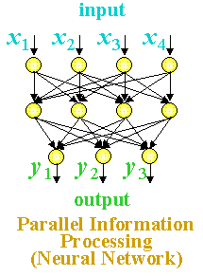
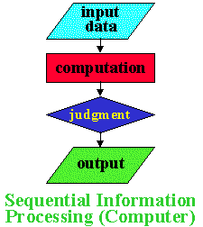
Features of Neural Nets
Neural Net Characteristics 1
Neural nets have many unique features:
Massive Parallel Processing:
Neural Nets update in parallel
Computers calculate in sequence

Slide 5
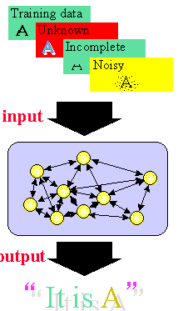
Neural Net Characteristics 2
Neural nets can learn:
Once a neural net is trained, it can handle unknown, incomplete or noisy data

Slide 6
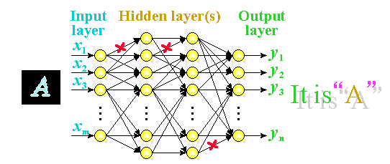
Neural Net Characteristics 3
Unlike computer memory, information is distributed over the entire network, so a failure in one part of the network does not prevent the system for producing the correct output.

Slide 7
Learning in Neural Nets
One of the powerful features of neural networks is learning.
Learning in neural networks is carried out by adjusting the connection weights among neurons.
It is similar to a biological nervous system in which learning is carried out by changing synapses connection strengths, among cells.
Learning may be classified into 2 categories:
(1) Supervised Learning
(2) Unsupervised Learning

Slide 8
OUTLINE
Introduction to Learning
Learning Methods
Introduction to Learning by Induction

Slide 9
Introduction to Learning
Learning
Learning is one of those everyday terms which is broadly and vaguely used in the English language
  Learning is making useful changes in our minds
  Learning is constructing or modifying representations of what is being experienced
  Learning is the phenomenon of knowledge acquisition in the absence of explicit programming
Herbert Simon, 1983
Learning denotes changes in the system that are
adaptive in the sense that they enable the system to do
the same task or tasks drawn from the same population
more efficiently and more effectively next time.

Slide 10
Learning is . . .
Learning involves the recognition of patterns in data or experience and then using that information to improve performance on another task

Slide 11
Implications
Learning involves 3 factors:
Learning changes the learner: for machine
learning the problem is determining the nature
of these changes and how to best represent them
changes
Learning leads to generalization: performance
must improve not only on the same task but on
similar tasks
generalization
Learning leads to improvements: machine
learning must address the possibility that
changes may degrade performance and find ways
to prevent it.
improvement

Slide 12
Learning Methods
There are two different kinds of information processing which must be considered in a machine learning system
  Inductive learning is concerned with determining general patterns, organizational schemes, rules, and laws from raw data, experience or examples.
  Deductive learning is concerned with determination of specific facts using general rules or the determination of new general rules from old general rules.

Slide 13
Learning Framework
There are four major components in a learning system:
Performance
Element
Environment
Learning
Element
Knowledge
Base

Slide 14
The Environment
The environment refers the nature and quality of information given to the learning element
The nature of information depends on its level (the degree of generality wrt the performance element)
  high level information is abstract, it deals with a broad class of problems
  low level information is detailed, it deals with a single problem.
The quality of information involves
  noise free
  reliable
  ordered

Slide 15
Learning Elements
Four learning situations
  Rote Learning
    environment provides information at the required level
  Learning by being told
    information is too abstract, the learning element must hypothesize missing data
  Learning by example
    information is too specific, the learning element must hypothesize more general rules
  Learning by analogy
    information provided is relevant only to an analogous task, the learning element must discover the analogy

Slide 16
Knowledge Base
Expressive
  the representation contains the relevant knowledge in an easy to get to fashion
Modifiable
  it must be easy to change the data in the knowledge base
Extendibility
  the knowledge base must contain meta-knowledge (knowledge on how the data base is structured) so the system can change its structure

Slide 17
Performance Element
Complexity
  for learning, the simplest task is classification based on a single rule while the most complex task requires the application of multiple rules in sequence
Feedback
  the performance element must send information to the learning system to be used to evaluate the overall performance
Transparency
  the learning element should have access to all the internal actions of the performance element

Slide 18
Rote Learning
Memorization - saving new knowledge to be retrieved when needed rather than calculated
Works by taking problems that the performance element has solved and memorizing the problem and the solution
Only useful if it takes less time to retrieve the knowledge than it does to recompute it

Slide 19
Checkers Example
A.L. Samuels Checkers Player (1959-1967)
The program knows and follows the rules of checkers
It memorizes and recalls board positions it has encountered in previous games

Slide 20
MinMax Game Tree
Checkers used a minmax game tree with a 3 move lookahead and a static evaluation function:
5
A
Your play from position A
There are 3 possible moves
For your opponent - there
are 2 moves out of B,
1 out of C and 2 out of D
B
C
D
5
3
3
E
F
G
H
I
Your play has
several choices
8
3
3
9
5
J
K
L
M
N
O
P
Q
8
3
1
3
9
2
5
3
Evaluate the boards
Move the maximum values up when it is your move
Move the minimum values up when it is your opponents
move
Finally, move the maximum up on your move

Slide 21
Learning Process
The checkers program would memorize a board position such as A and its value 5 - [A,5].
The next time the system ran into A , it used the memorized value of 5 rather than compute the static evaluation function
Result: a lookahead of 5, 7 . . .
S
R
T
A
Based on a lookahead of 3

Slide 22
Introduction to Learning by Induction
Learning by Example
Learning by induction is a general learning strategy where a concept is learned by drawing inductive inferences from a set of facts
AI systems that learn by example can be viewed as searching a concept space by means of a decision tree
The best known approach to constructing a decision tree is called ID3
Iterative Dichotomizer 3 - developed by
J. Ross Quinlan in 1975

Slide 23
ID3 Process
ID3 begins with a set of examples (known facts)
It ends with a set of rules in the form of a decision tree which may then be applied to unknown cases
It works by recursively splitting the example set into smaller sets in the most efficient manner possible.

Slide 24
Possible Quiz
What is inductive learning?
How does rote learning work?
What is ID3?
Summary
Introduction to Learning
Learning Methods
Introduction to Learning by Induction

Slide 25
Review – Learning by Example
Learning by induction is a general learning strategy where a concept is learned by drawing inductive inferences from a set of facts
AI systems that learn by example can be viewed as searching a concept space by means of a decision tree
The best known approach to constructing a decision tree is called ID3

Slide 26
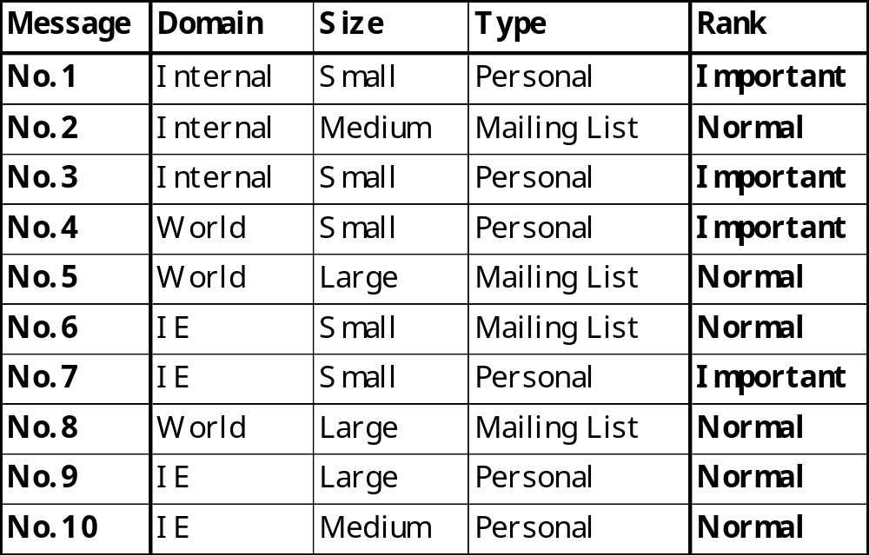
Review – Example of Learning
User is observed to file email messages as follows:-
Learn users behaviour from examples in order to automate this process.

Slide 27
OUTLINE
Background
Decision Trees
ID3

Slide 28
Background
We are interested in datasets consisting of a number of records
Each record has:
  A set of attribute-value pairs
  E.g. “Color: green, Temperature: 120ºC”
  A classification
  E.g. “Risk: Low”
We assume that the classification is dependent on the attributes
  We are assuming that the dataset “makes sense”

Slide 29
Inductive Learning
Interesting problem: Can we find the mapping between the attributes and the classifications only using the dataset?
This is the purpose of an inductive learning algorithm
In practice, we can only find an approximation to the true mapping
  Only a hypothesis, but still useful:
    Classification of new records (prediction)
    Identifying patterns in the dataset (data mining)

Slide 30
Classification Problem
We model each record as a pair (x, y), where x is the set of attributes and y is the classification
We are trying to find a function f which models the data:
  We want to find f such that f(x) = y for as many records in the dataset as possible
To make things easier, we will use a fixed set of attributes and discrete classes

Slide 31
Choosing a Classifier
Some issue to consider:
  Construction time
  Runtime performance
  Transparency
  Updateability
  Scalability
All these rest on how f is represented by the model

Slide 32
Common Classifiers
Analytical (mathematical) models
Nearest-neighbor classifiers
Neural networks
Genetic programming
Genetic algorithms (classifier systems)
Decision trees

Slide 33
Decision Trees
What is a Decision Tree?
  it takes as input the description of a situation as a set of attributes (features) and outputs a yes/no decision (so it represents a Boolean function)
  each leaf is labeled "positive” or "negative", each node is labeled with an attribute (or feature), and each edge is labeled with a value for the feature of its parent node
Attribute-value language for examples
  in many inductive tasks, especially learning decision trees, we need a representation language for examples
    each example is a finite feature vector
    a concept is a decision tree where nodes are features

Slide 34
History
Independently developed in the 60’s and 70’s by researchers in ...
  Statistics: L. Breiman & J. Friedman - CART (Classification and Regression Trees)
  Pattern Recognition: Uof Michigan - AID, G.V. Kass - CHAID (Chi-squared Automated Interaction Detection)
  AI and Info. Theory: R. Quinlan - ID3, C4.5 (Iterative Dichotomizer)

Slide 35
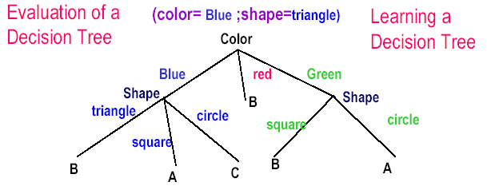
Decision Tree Representation
Decision Trees are classifiers for instances represented as features vectors. (color= ;shape= ;label=)
  Nodes are tests for feature values;
  There is one branch for each value of the feature
  Leaves specify the categories (labels)
  Can categorize instances into multiple disjoint categories

Slide 36
Example
Problem: How do you decide to leave a restaurant?
Variables:
Alternative Whether there is a suitable alternative restaurant nearby.
Bar Is there a comfortable bar area?
Fri/Sat True on Friday or Saturday nights.
Hungary How hungry is the subject?
Patrons How many people in the restaurant?
Price Price range.
Raining Is it raining outside?
Reservation Does the subject have a reservation?
Type Type of Restaurant.
Stay? Stay or Go

Slide 37
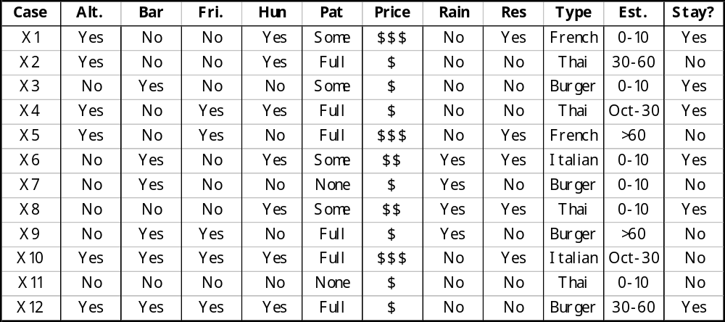
Method
Gather test data using the variables and observe the decision.

Slide 38
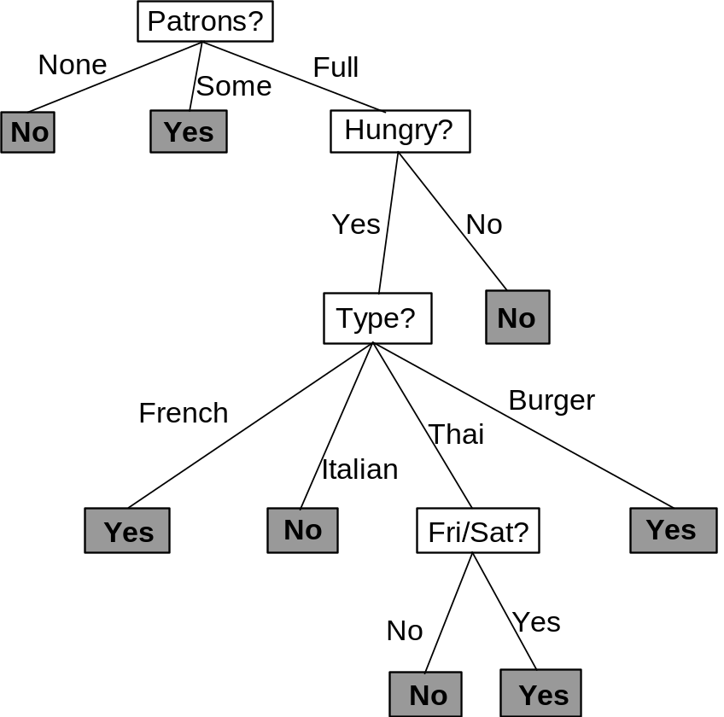
Result
Very good Decision Tree
  Classifies all examples correctly
  Very few nodes

Slide 39
How?
Given: Set of examples with Pos. & Neg. classes
Problem: Generate a Decision Tree model to classify a separate (validation) set of examples with minimal error
Approach: Occam’s Razor - produce the simplest model that is consistent with the training examples -> narrow, short tree. Every traverse should be as short as possible
Formally: Finding the absolute simplest tree is intractable, but we can at least try our best

Slide 40
Exhaustive Search
We could try to build every possible tree and the select the best one
How many trees are there for a specific problem?
  Given a dataset with 5 different binary attributes
  How many trees are there in this case?

Slide 41
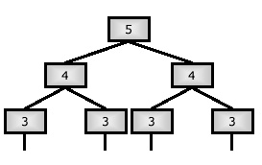
Answer
The resulting tree must contain at least 1 node, and can be at most 5 levels deep
  We can choose any of the 5 attributes at the root node
  In the next level, we have 4 attributes to chose from, for each branch
  This gives 5 x (4 x 4) x (3 x 3 x 3 x 3) x … x 1
  This is 5 x 42 x 34 x 28 x 1 = 1658880 (for a tree of depth 5)
  The total is 1659471 for all possible trees (depths 5,4,3,2&1)

Slide 42
Producing the Best DT
Heuristic (strategy) 1: Grow the tree from the top down. Place the most important variable test at the root of each successive subtree
The most important variable:
  the variable (predictor) that gains the most ground in classifying the set of training examples
  the variable that has the most significant relationship to the response variable
  to which the response is most dependent or least independent

Slide 43
ID3 Process
ID3 begins with a set of examples (known facts)
It ends with a set of rules in the form of a decision tree which may then be applied to unknown cases
It works by recursively splitting the example set into smaller sets in the most efficient manner possible.

Slide 44
Algorithm
Given a set of training examples, E, which fall into one of two classes (+ or -)
If all the examples of E are negative then create a
negative node and stop
If all the examples of E are positive then create a
positive node and stop
ID3 uses entropy as the criterion for selecting the
next attribute
Otherwise use a criterion to select an attribute A
for a new decision node
Use A to partition E into subsets and apply the
algorithm to each subset

Slide 45
Aside: Entropy
Entropy is the basis of Information Theory
Entropy is a measure of randomness, hence the smaller the entropy the greater the information content
Given a message with n symbols in which the ith symbol has probability p_{i} of appearing, the entropy of the message is:
Σ
n
H =
- (p_{i}log₂p_{i})
i=1

Slide 46
Entropy in ID3
For a selected attribute value A = v_{i}, determine the number of examples with v_{i} that are negative (N_{n}) and the number of examples with v_{i} that are positive (N_{p}).
(
)
)
Σ
[
N_{p}
(
N_{n}
]
n
-
+ N_{n}log₂
H =
N_{p}log₂
N_{p} + N_{n}
N_{p} + N_{n}
i=1

Slide 47
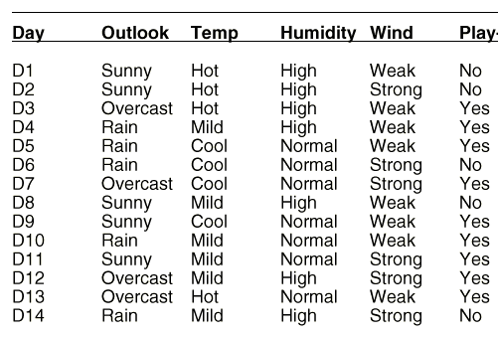
Example
Learn when it is best to play tennis
Observe the weather for 14 days and note when tennis was played:
So, what is the general rule?

Slide 48
Constructing the Decision Tree
Because the examples are neither all positive or all negative, the best discriminator must be selected to become the root node (the one with the smallest entropy)
Attribute Values N_{n} N_{p} Entropy
Outlook Sunny 3 2
Overcast 0 4
Rain 2 3
9.7096
Temp Hot 2 2
Mild 2 4
Cool 1 3
12.7549
Humidity High 4 3
Normal 1 6
11.0383
Windy Weak 2 6
Strong 3 3
12.4902

Slide 49
Constructing the Next Level
Now look for the minimum entropy among the three outlook cases:
Outlook
sunny
rain
overcast
Humidity
Windy
High
Normal
Weak
Strong
No Yes
Yes
Yes No
Finished - what happened to Temp?
For the Sunny cases only:
For the Rain cases only:
Temp Hot 2 0
Mild 1 1
Cool 0 1
Humidity High 3 0
Low 0 2
Windy Weak 2 1
Strong 1 1
Temp Hot 0 0
Mild 1 2
Cool 1 1
Humidity High 1 1
Low 1 2
Windy Weak 0 3
Strong 2 0
2.0
4.75
0
4.75
4.75
0

Slide 50
Rules
The rules for playing tennis are given by the decision tree:
Outlook
sunny
rain
overcast
Humidity
Windy
High
Normal
Weak
Strong
No Yes
Yes
Yes No
If the outlook is sunny and the humidity is high
Then do not play tennis

Slide 51
Possible Quiz
What is the purpose of an inductive learning algorithm?
What is Entropy?
What variable is placed at the root node of a Decision Tree?
Summary
Background
Decision Trees
ID3

Slide 52
Review – Decision Trees
What is a Decision Tree?
  it takes as input the description of a situation as a set of attributes (features) and outputs a yes/no decision (so it represents a Boolean function)
  each leaf is labeled "positive” or "negative", each node is labeled with an attribute (or feature), and each edge is labeled with a value for the feature of its parent node
ID3 is one example of an algorithm that will create a Decision Tree

Slide 53
Review – Advantages
Proven modeling method for 20 years
Provides explanation and prediction
Useful for non-linear mappings
Generalizes well given sufficient examples
Rapid training and recognition speed
Has inspired many inductive learning algorithms using statistical regression

Slide 54
Review - Disadvantages
Only one response variable at a time
Different significance tests required for nominal and continuous responses
Discriminate functions are often suboptimal due to orthogonal decision hyperplanes
No proof of ability to learn arbitrary functions
Can have difficulties with noisey data

Slide 55
Overfitting & Pruning
Overfitting
OUTLINE
Overfitting & Pruning, Constraints, Rules
A tree generated may over-fit the training examples due to noise or too small a set of training data
Two approaches to avoid over-fitting:
  (Stop earlier): Stop growing the tree earlier
  (Post-prune): Allow over-fit and then post-prune the tree
Approaches to determine the correct final tree size:
  Separate training and testing sets or use cross-validation
  Use all the data for training, but apply a statistical test (e.g., chi-square) to estimate whether expanding or pruning a node may improve over entire distribution
  Use Minimum Description Length (MDL) principle: halting growth of the tree when the encoding is minimized.

Slide 56
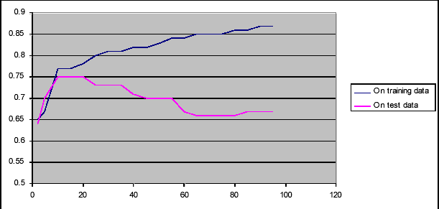
Overfitting Effects
The effect of overfitting is that it produces a tree that works very well on the training set but produces a lot of errors on the test set
Accuracy on training and test data

Slide 57
Avoiding Overfitting
Two basic approaches
  Prepruning: Stop growing the tree at some point during construction when it is determined that there is not enough data to make reliable choices.
  Postpruning: Grow the full tree and then remove nodes that seem not to have sufficient evidence.
Methods for evaluating subtrees to prune:
  Cross-validation: Reserve hold-out set to evaluate utility
  Statistical testing: Test if the observed regularity can be dismissed as likely to be occur by chance
  Maximum Description Length: Is the additional complexity of the hypothesis smaller than remembering the exceptions

Slide 58
Pruning 1
Subtree Replacement: merge a subtree into a leaf node
  Using a set of data different from the training data
  At a tree node, if the accuracy without splitting is higher than the accuracy with splitting, replace the subtree with a leaf node; label it using the majority class
color
Suppose with test set we find 3 red “no” examples, and
1 blue “yes” example. We can replace the tree with a
single “no” node. After replacement there will be only
2 errors instead of 5.
red
blue
yes
no
1
2

Slide 59
Pruning 2
A post-pruning, cross validation approach
  Partition training data into “grow” set and “validation” set.
  Build a complete tree for the “grow” data
  Until accuracy on validation set decreases, do:
    For each non-leaf node in the tree
    Temporarily prune the tree below; replace it by majority vote.
    Test the accuracy of the hypothesis on the validation set
    Permanently prune the node with the greatest increase in accuracy on the validation test

Slide 60
Constraints
Motivation
Necessity of Constraints
  Decision tree can be
    Complex with hundreds or thousands of nodes
    Difficult to comprehend
  Users are only interested in obtaining an overview of the patterns in their data
    A simple, comprehensible, but only approximate decision tree is much more useful
Necessity of Pushing constraints into the tree-building phase
  In tree-building phase, may waste I/O on building tree which will be pruned by applying constraints

Slide 61
Possible Constraints
Constraints
  Size : the number of nodes
    For a given k, find a subtree with size at most k that minimizes either the total MDL cost or the total number of misclassified records.
  Inaccuracy : the total MDL cost or the number of misclassified records
    For a given C, find a smallest subtree whose total MDL cost or the total number of misclassified records does not exceed C.

Slide 62
Possible Algorithm
Input
  Decision tree generated by traditional algorithm
  Size constraint : k
Algorithm
  Compute minimum MDL cost recursively
    minCost = the MDL cost when the root become a leaf.
    For k₁ = 1 to k–2 {
    minCost = Min (minCost, minimum MDL cost whose children have constraint k₁, k – 1 – k₁ for each)
    Delete all nodes which are not in the minimum cost subtree

Slide 63
RULES
DT to Rules
A Decision Tree can be converted into a rule set
  Straightforward conversion: rule set overly complex
  More effective conversions are not trivial
Strategy for generating a rule set directly: for each class in turn find rule set that covers all instances in it (excluding instances not in the class)
This approach is called a covering approach because at each stage a rule is identified that covers some of the instances

Slide 64
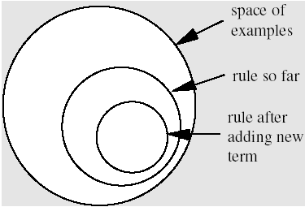
A Simple Covering Algorithm
Generates a rule by adding tests that maximize rule’s accuracy
Similar to situation in decision trees: problem of selecting an attribute to split on
Each new test reduces the rule’s coverage:

Slide 65
Selecting a test
Goal: maximizing accuracy
  t: total number of instances covered by rule
  p: positive examples of the class covered by rule
  t-p: number of errors made by rule
Select test that maximizes the ratio p/t
We are finished when p/t = 1 or the set of instances can’t be split any further

Slide 66
Example: contact lenses data
Rule we seek: If ? then recommendation = hard
Possible tests:
  Tear production rate = Normal 2/8
  Tear production rate = Reduced 0/12
  Astigmatism = yes 4/12
  Astigmatism = no 0/12
  Spectacle prescription = Hypermetrope 1/12
  Spectacle prescription = Myope 3/12
  Age = Presbyopic 1/8
  Age = Pre-presbyopic 1/8
  Age = Young 2/8
Out of 12 cases with Astigmatism 4 had hard lenses
Best case

Slide 67
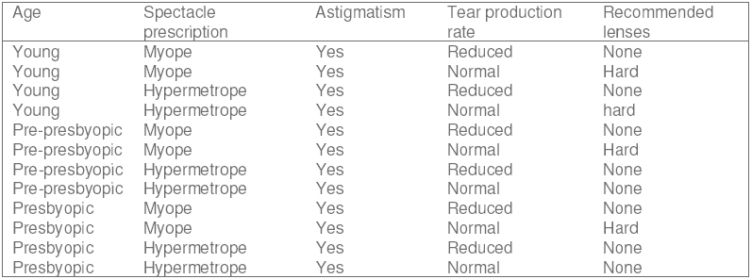
Modified Rule
Rule with best test added:
  If astigmatism = yes then recommendation = hard
Instances covered by modified rule:
This is really not a very good rule

Slide 68
Further Refinement
Current state: If astigmatism = yes and ? then recommendation = hard
Possible tests:
  Tear production rate = Normal 4/6
  Tear production rate = Reduced 0/6
  Spectacle prescription = Hypermetrope 1/6
  Spectacle prescription = Myope 3/6
  Age = Presbyopic 1/4
  Age = Pre-presbyopic 1/4
  Age = Young 2/4
x
x
x
x

Slide 69
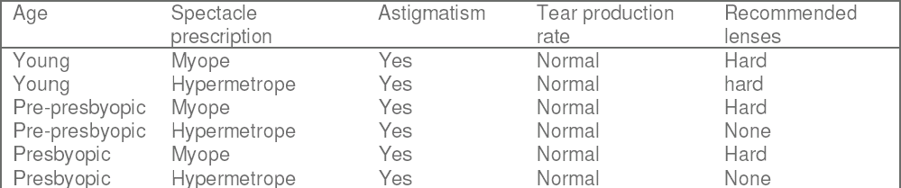
New Rule
Rule with best test added:
  If astigmatism = yes and tear production rate = normal then recommendation = hard
Instances covered by modified rule:

Slide 70
Further Refinement
Current state: If astigmatism = yes and tear production rate = normal and ? then recommendation = hard
Possible tests:
  Spectacle prescription = Hypermetrope 1/3
  Spectacle prescription = Myope 3/3
  Age = Presbyopic 1/2
  Age = Pre-presbyopic 1/2
  Age = Young 2/2
Tie between the second and the fifth test
  We choose the one with greater coverage

Slide 71
Result
Final rule:
  If astigmatism = yes and tear production rate = normal and spectacle prescription = myope then recommendation = hard
Second rule for recommending hard lenses: (built from instances not covered by first rule)
  If age = young and astigmatism = yes and tear production rate = normal then recommendation = hard
These two rules cover all hard lenses:
  Process is repeated with other two classes

Slide 72
Possible Quiz
What is overfitting?
What is pruning?
Name one possible constraint.
SUMMARY
Overfitting & Pruning
Constraints
Rules

Slide 73
Supervised Learning
In supervised learning, the network is presented with inputs together with the target (teacher signal) outputs.
Then, the neural network tries to produce an output as close as possible to the target signal by adjusting the values of internal weights.
The most common supervised learning method is the “error correction method”

Slide 74
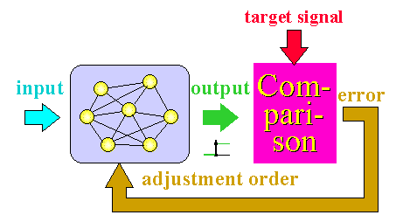
Error Correction Method
Error correction method is used for networks which their neurons have discrete output functions.
Neural networks are trained with this method in order to reduce the error (difference between the network's output and the desired output) to zero.

Slide 75
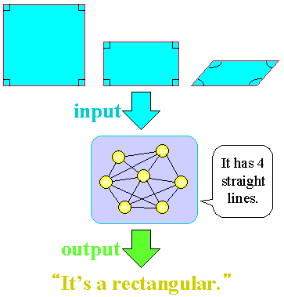
Unsupervised Learning
In unsupervised learning, there is no teacher (target signal) from outside and the network adjusts its weights in response to only the input patterns.
A typical example of unsupervised learning is
Hebbian
learning.

Slide 76
Common NN Features
“weight” = strength of connection
threshold = value of weighted input below which no response is produced
signals may be:
  real-valued, or
  binary-valued:
    “unipolar” {0, 1}
    “bipolar” {-1, 1}

Slide 77
McCulloch/Pitts Neuron
One of the first neuron models to be implemented
Its output is 1 (fired) or 0
Each input is weighted with weights in the range -1 to + 1
It has a threshold value, T
x₁
The neuron fires if the following
inequality is true:
w₁
x₂
w₂
Σ
T
x₁w₁ + x₂w₂ + x₃w₃ > T
w₃
x₃

Slide 78
Single Neuron Application
GOAL: Construct an MCP (McCulloch/Pitts) neuron which will implement the function below:
PROBLEM: find the threshold, T,
and the weights w₁ and w₂ where:
x1 x2 F
0 0 0
0 1 1
1 0 1
1 1 1
F is 1 if x₁w₁ + x₂w₂ > T
Each line of the function table places conditions on the
unknown values:
0 < T
w₂ > T
What is this function?
x₁
w₁ > T
w₁ + w₂ > T
w₁
Σ
T
w₂
w₁ and w₂ = 0.7 T = 0.5 works
x₂

Slide 79
NN Development
Define Problem
There is no single methodology for NN development
  A suggested approach is:
Data Selection,
Preparation,
Preprocessing
Determine Best-Suited
Algorithm
Train Network
Trained
Successfully?
Test Network
Tested
Successfully?
Run/Use Network

Slide 80
Learning in Neural Nets (again)
The operation of a neural network is determined by the values of the interconnection weights
  There is no algorithm that determines how the weights should be assigned in order to solve a specific problems
  Hence, the weights are determined by a learning process

Slide 81
Hebbian Learning
The oldest and most famous of all learning rules is Hebb’s postulate of learning:
“When an axon of cell A is near enough to excite a cell B
and repeatedly or persistently takes part in firing it, some
growth process or metabolic changes take place in one or
both cells such that A’s efficiency as one of the cells firing
B is increased”
Application to artificial neurons:
If two interconnected neurons are both “on” at the same
time, then the weight between them should be increased

Slide 82
Hebb’s Algorithm
Step 0: initialize all weights to 0
Step 1: Given a training input, s, with its target output, t, set the activations of the input units: x_{i} = s_{i}
Step 2: Set the activation of the output unit to the target value: y = t
Step 3: Adjust the weights: w_{i}(new) = w_{i}(old) + x_{i}y
Step 4: Adjust the bias (just like the weights): b(new) = b(old) + y

Slide 83
Example
PROBLEM: Construct a Hebb Net which performs like an AND function, that is, only when both features are “active” will the data be in the target class.
TRAINING SET (with the bias input always at 1):
x1 x2 bias Target
1 1 1 1
1 -1 1 -1
-1 1 1 -1
-1 -1 1 -1
1
b
x₁
w₁
Σ
0
w₂
x₂

Slide 84
Training – First Input
Initialize the weights to 0
w₁(new) = w₁(old) + x₁t
Present the first input (1 1 1) with a target of 1
= 0 + 1 = 1
w₂(new) = w₂(old) + x₂t
Update the weights:
= 0 + 1 = 1
b(new) = b(old) + t
= 0 + 1 = 1
1
0
1
1
0
Σ
0
1
1
x₁
x₁
1
Σ
0
1
0
x₂
1
x₂

Slide 85
Training – Second Input
Present the second input:
(1 -1 1) with a target of -1
Update the weights:
w₁(new) = w₁(old) + x₁t
= 1 + 1(-1) = 0
w₂(new) = w₂(old) + x₂t
= 1 + (-1)(-1) = 2
1
b(new) = b(old) + t
1
= 1 + (-1) = 0
1
1
Σ
0
-1
x₁
1
1
-1
0
x₂
x₁
0
Σ
0
2
x₂

Slide 86
Training – Third Input
Present the third input: (-1 1 1) with a target of -1
Update the weights:
w₁(new) = w₁(old) + x₁t
= 0 + (-1)(-1) = 1
w₂(new) = w₂(old) + x₂t
= 2 + 1(-1) = 1
1
b(new) = b(old) + t
0
= 0 + (-1) = -1
-1
0
Σ
0
-1
x₁
1
2
1
x₂
-1
x₁
1
Σ
0
1
x₂

Slide 87
Training – Fourth Input
Present the fourth input:
(-1 -1 1) with a target of -1
Update the weights:
w₁(new) = w₁(old) + x₁t
= 1 + (-1)(-1) = 2
w₂(new) = w₂(old) + x₂t
= 1 + (-1)(-1) = 1
b(new) = b(old) + t
1
-1
= -1 + (-1) = -2
x₁
-1
1
Σ
0
-1
1
-1
1
-2
x₂
x₁
2
Σ
0
2
x₂

Slide 88
Final Neuron
This neuron works:
x1 x2 bias Target
1 1 1 1
1 -1 1 -1
-1 1 1 -1
-1 -1 1 -1
1
1
1
1
1
1 1 1 1
-2
-1
-1
-1
-1
1
1
-1
1 -1 1 -1
1
2
Σ
0
x₁
-1 1 1 -1
-1
-1
1
1
2
-1 -1 1 -1
x₂
1*2 + 1*2 + 1*(-2) = 2 > 0
(-1)*2 + 1*2 +1*(-2) = -2 < 0
1*2 + (-1)*2 + 1*(-2) = -2 < 0
(-1)*2 + (-1)*2 + 1 *(-2) = -6 <0

Slide 89
Possible Quiz
What is the difference between supervised and
unsupervised learning?
What is the principle behind Hebbian learning?
Describe a MP Neuron.
SUMMARY
Features of Neural Nets
Learning in Neural Nets
McCulloch/Pitts Neuron
Hebbian Learning

